Slide 1
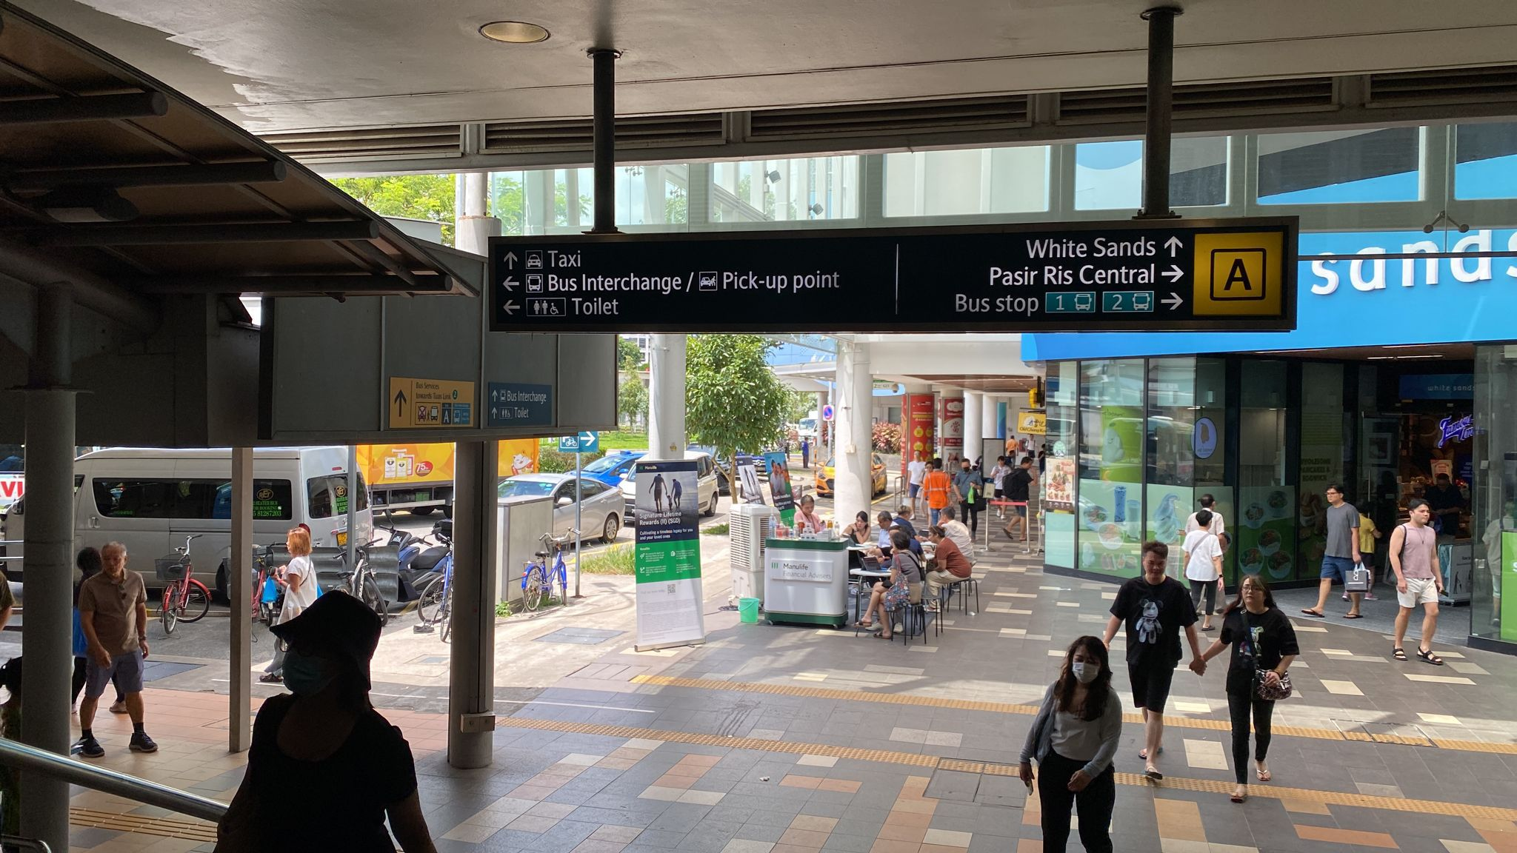
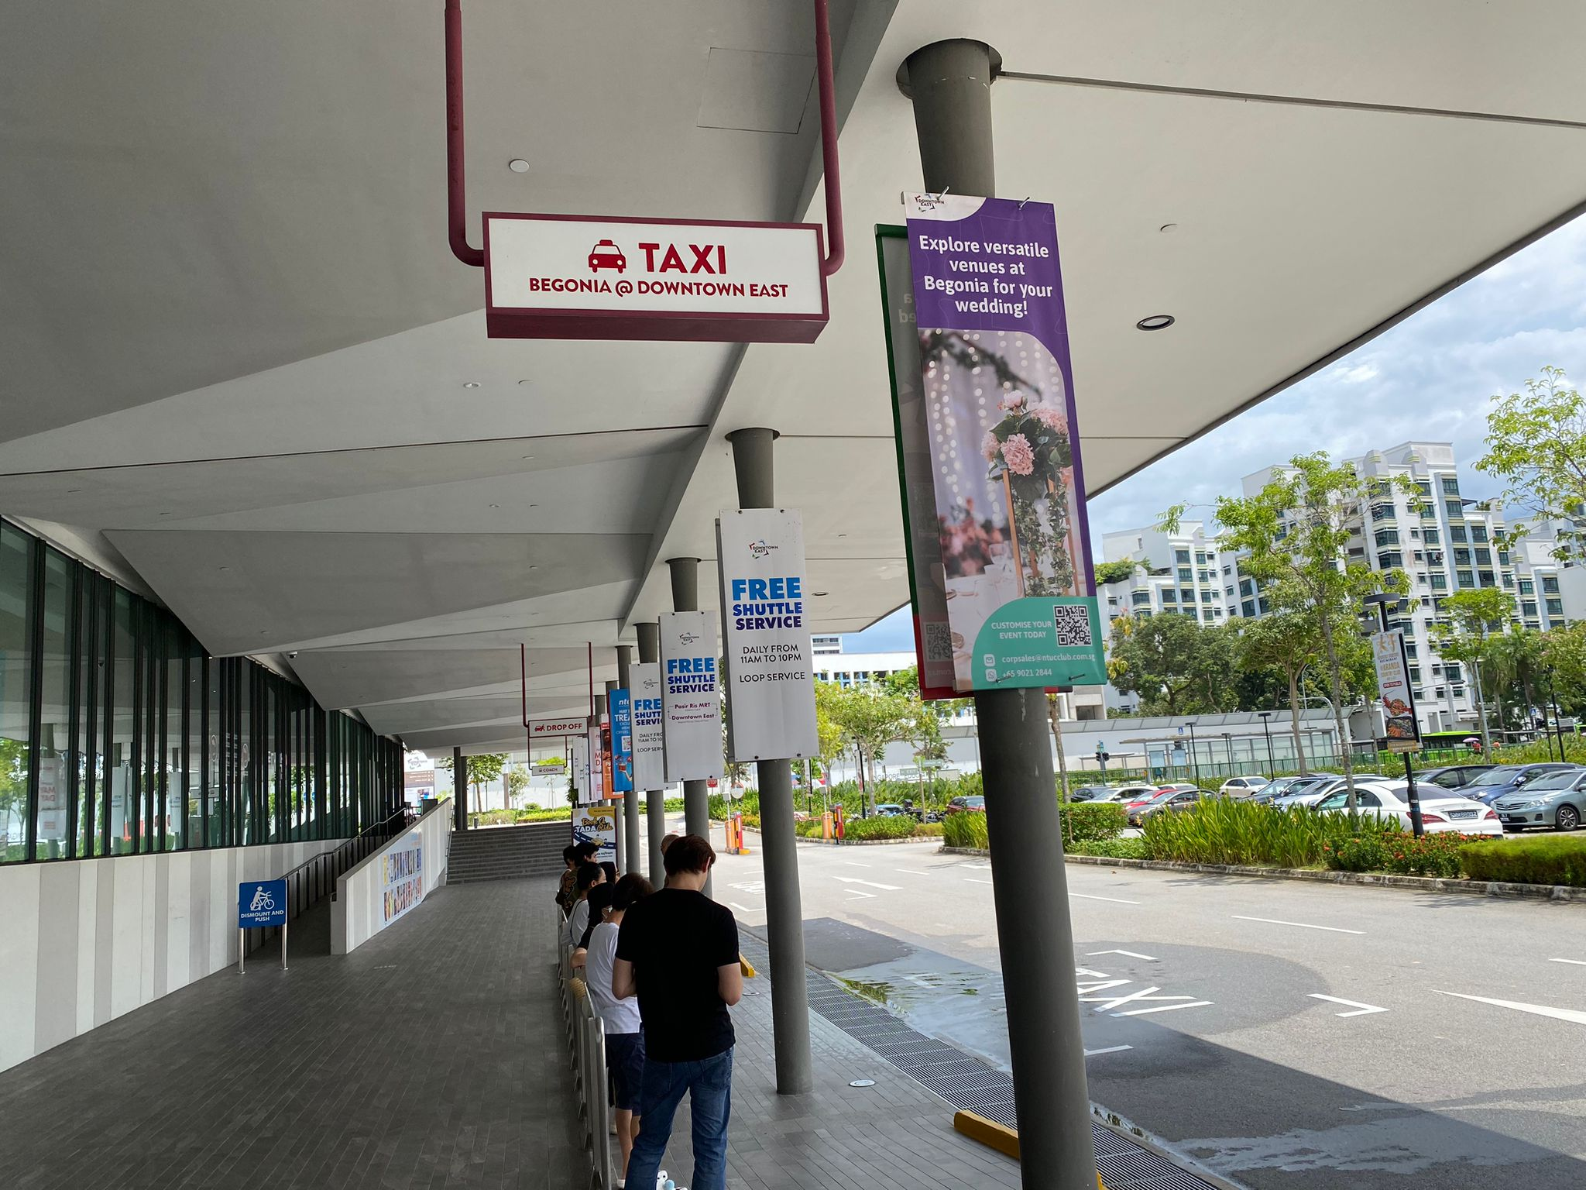
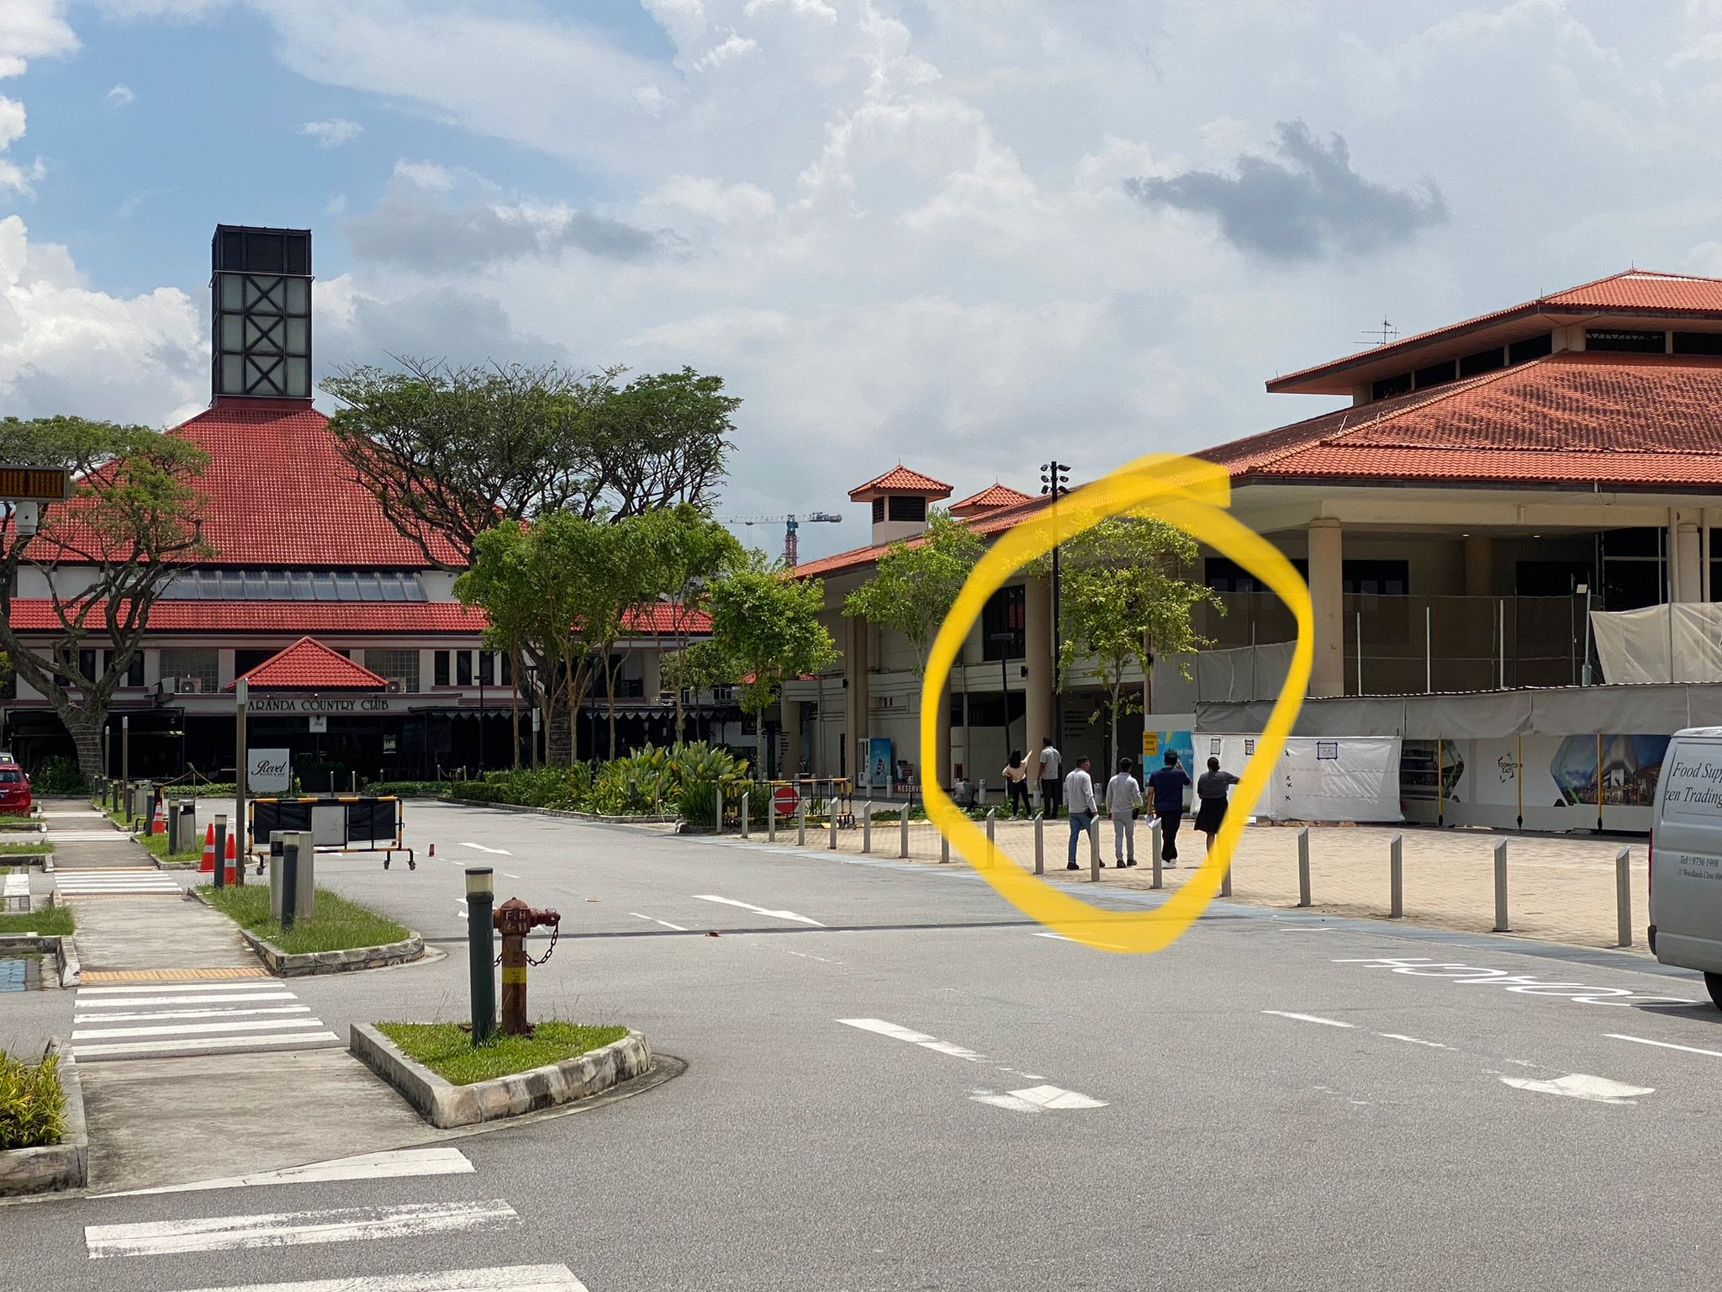
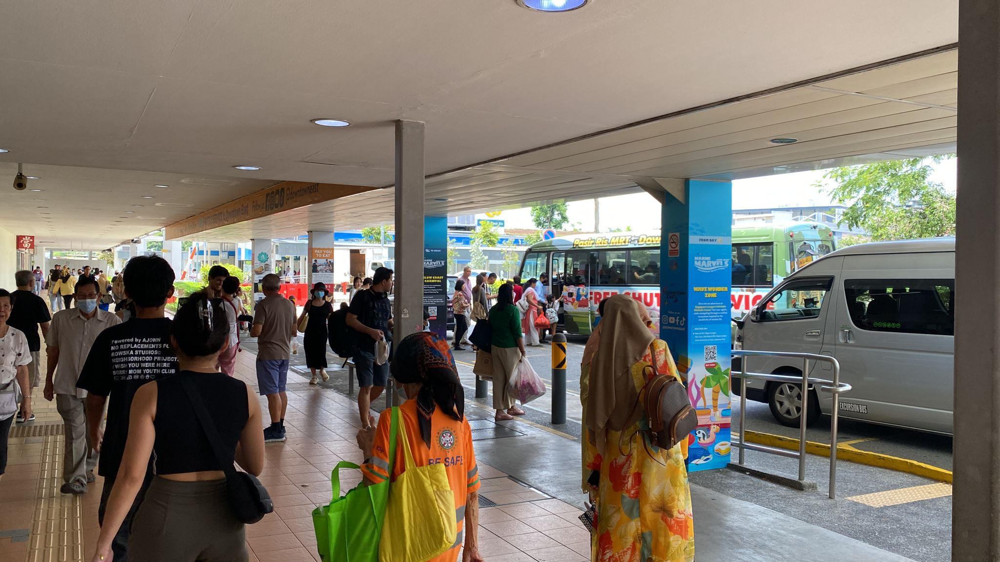
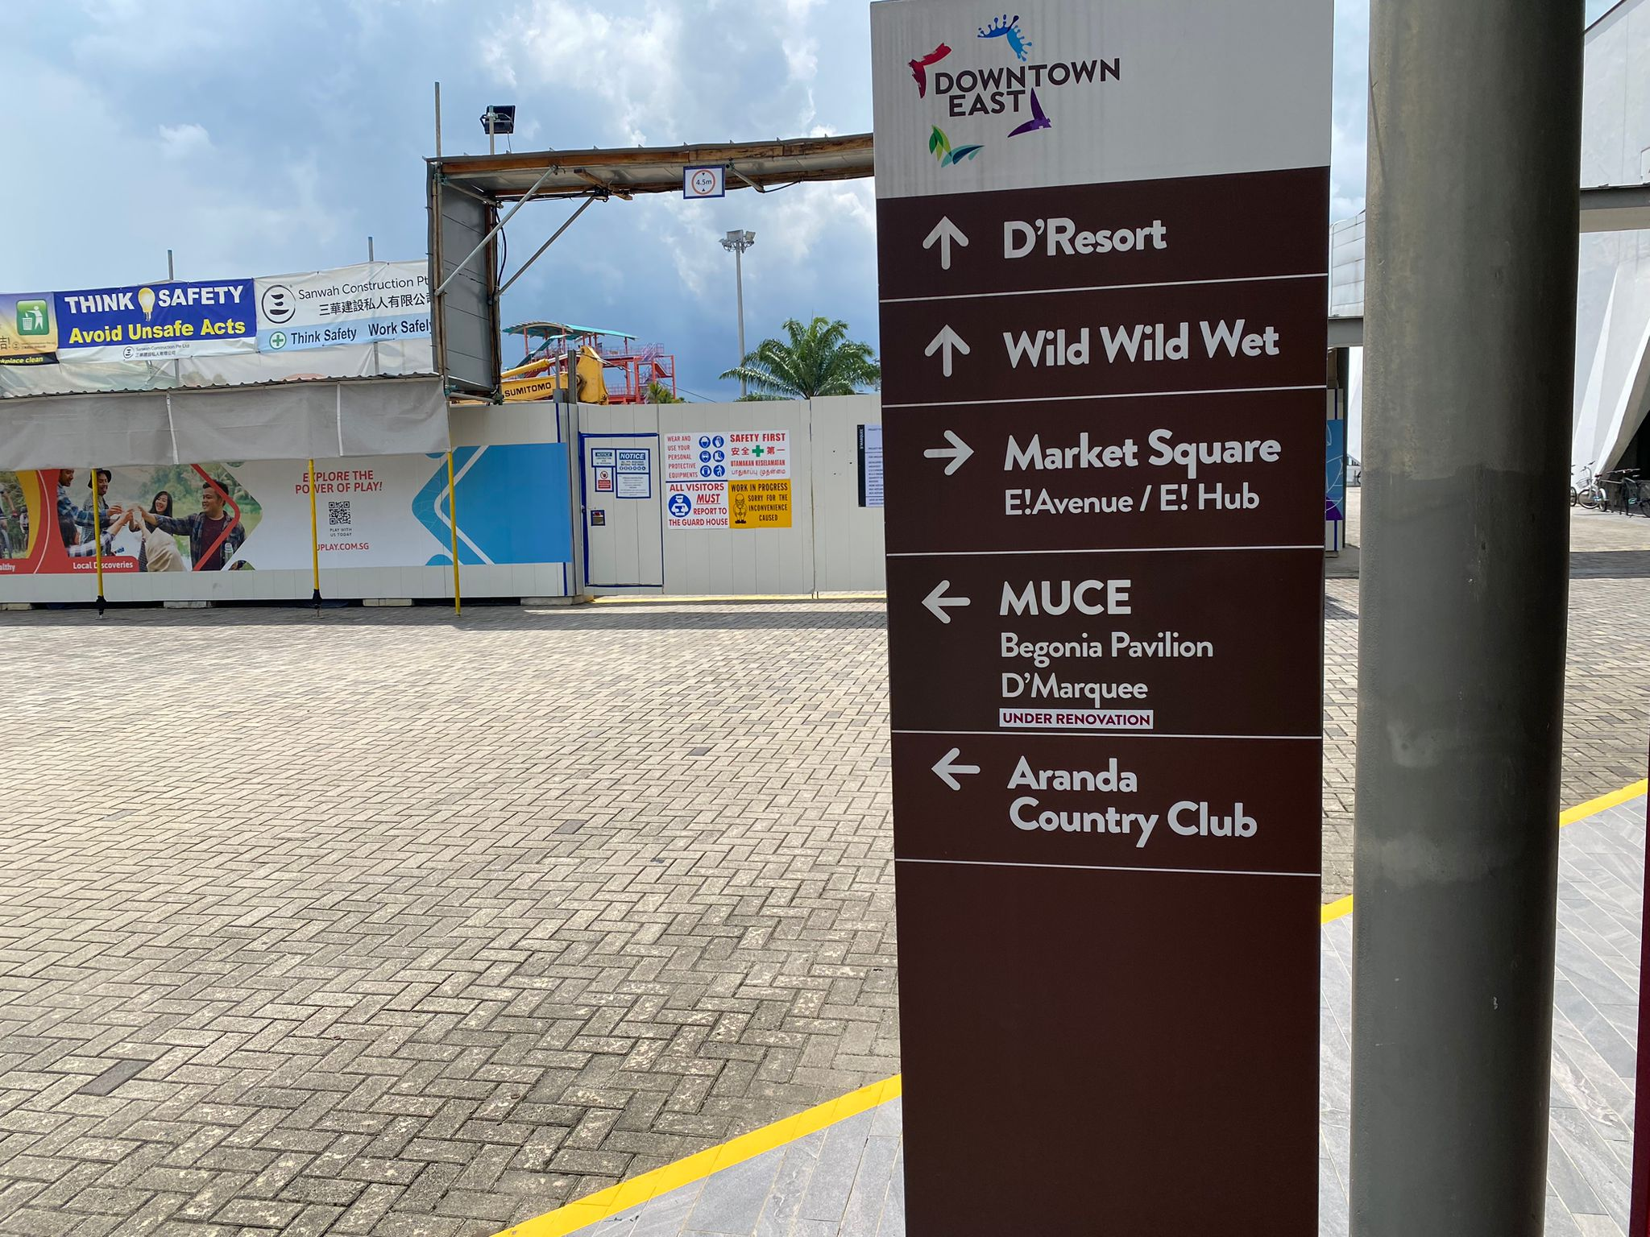
Kyorugi Referee Seminar 2024 Downtown East (Begonia Ballroom – Level Begonia Pavilion) – How To Get There?
Look our for Signages (Begonia Pavilion)
Via MRT
East West (Green) Line to Pasir Ris station
Proceed towards Exit A
Make a left turn walk towards Taxi-stand and Pick-up point
Downtown East Shuttle Buss ferry passengers directly to the venue
*Frequency is approx. every 15 to 20 mins
At Downtown East Taxi Stand / Drop Off Point:
Walk towards this building on your right and proceed
via lift or stairs to level 2 of the Begonia Pavilion
Turn left upon seeing this sign

Slide 3
